Slide 1
Thesis Pictures

Slide 2
CSR: row_ptr
0
1
2
CSR: col_ind
0
1
CSR: value
1
-2
-3
1
1
-4
-5
1

Slide 3
Parent Class: CSolver
CSolver
CSysMatrix Jacobian
CEulerSolver
CNSSolver
CSysVector rhs & sol
CTurbSolver
CTurbSASolver
CSysSolve System
CTurbSSTSolver
A
B
B是A的子类
A
B
B是A的类成员变量

Slide 6
warp0
warp1
warp2
warp3
warp4
warp5
warp6

Slide 8
A⁻¹
B
C
D
warp0
warp1
warp2
warp3
warp4
warp5
warp6

Slide 10
lane_Id_div_16 = 0
lane_Id_div_16 = 1
线程
共享内存

Slide 11
线程
共享内存

Slide 13
1
2
3
4
5
6
7
8
9

Slide 14
1
2
3
4
5
6
7
8
9

Slide 16
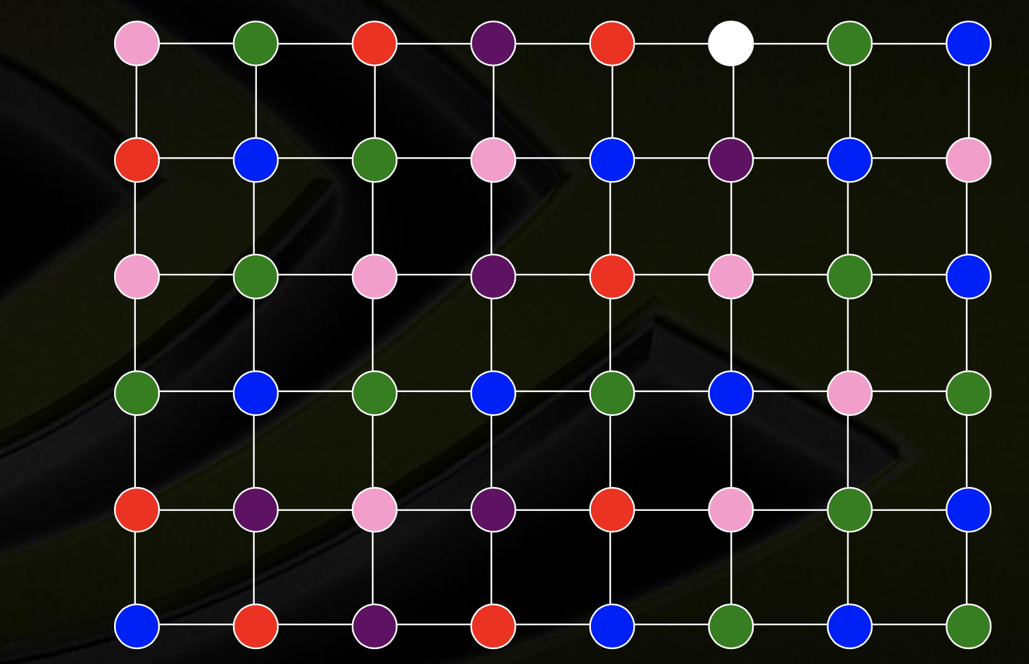

Slide 19
5
8
当地最大值
2
4
6
7
当地最小值
1
3
邻点

Slide 21
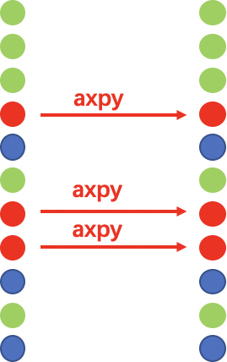
向量校正

